Slide 1
Equity Matters! Lessons learned from adult bicycling education case studies.

Slide 2
Equity
Planners:
“…professionals that work to improve the welfare of people and their communities by creating more convenient, equitable, healthful, efficient, and attractive places for present and future generations”—APA
Notes:
Access to resources, to choice
Extent of/distribution of public investments
Representation/identity
Social capital, access to government leaders
Role of advocacy organizations

Slide 3
Case Studies
Brick City Bike Collective – Newark, NJ
Local advocacy and bicycle education - “Making Newark streets safer and more welcoming for bicyclists”
Girls on Bikes – Newark, NJ
Women, equity, and cultural frames - “Creating a Culture of Unstoppable Women”
D&R Greenway Land Trust – Trenton, NJ
“This Dollar May Save Your Life” Campaign – bicycle safety education campaign
Urban Bike Project – Wilmington, DE
Local advocacy organization with strong explicit equity focus

Slide 4
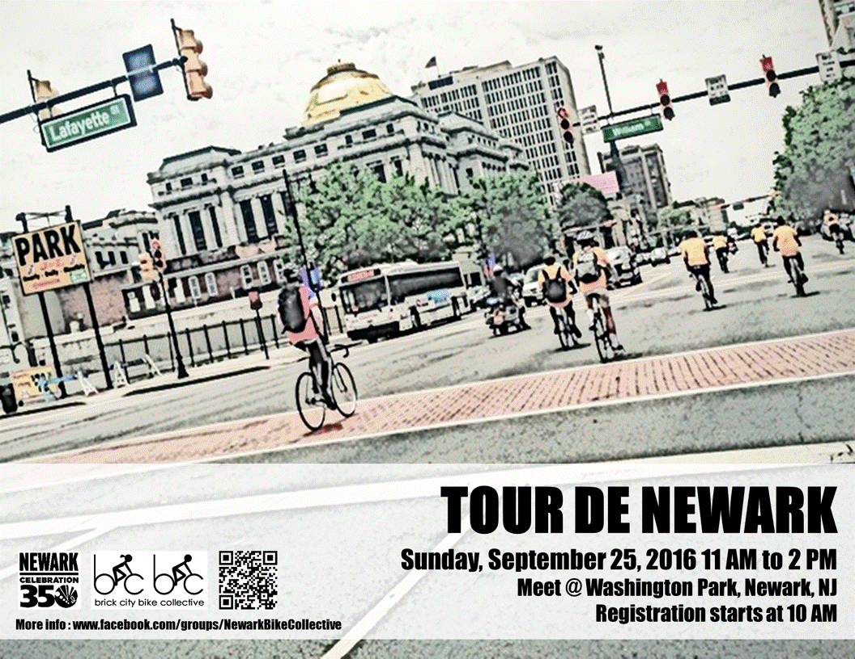
Brick City Bike Collective
To make Newark streets safer and more welcoming for bicyclists by promoting additional bicycle infrastructure and a connected network, educating the city and citizens on cycling issues, and assisting with group rides.
Tour de Newark
Cherry Blossom Bike Ride
Notes:
Active since 2008
Changes in leadership; NO formal leadership or Board of Directors
Entirely volunteer run, very inforaml structure (sporadic meetings)
Current director new to Newark in 2013

Slide 5
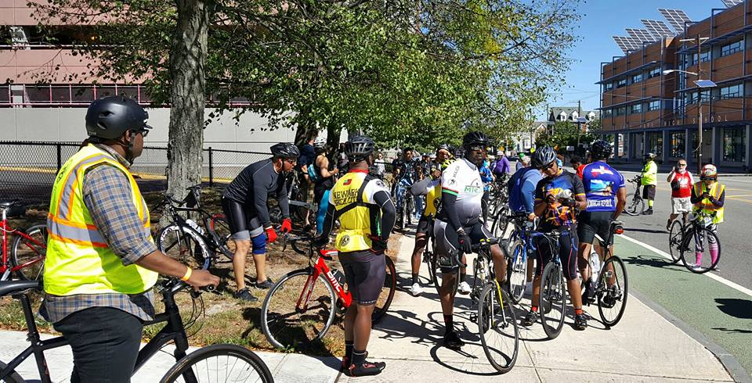
Brick City Bike Collective
More active in prior years when it was working with the Boys and Girls Club bike shop running education programs, repair classes, and a bicycle exchange program.
Had use of a building up until late December 2015 (lost to flooding)
Notes:
With the opening of a new bicycle shop in downtown Newark by two people who are active in BCBC and understand the organization, the group is hopeful that they might be able to “plug into the space” to use for bicycle maintenance classes.

Slide 6
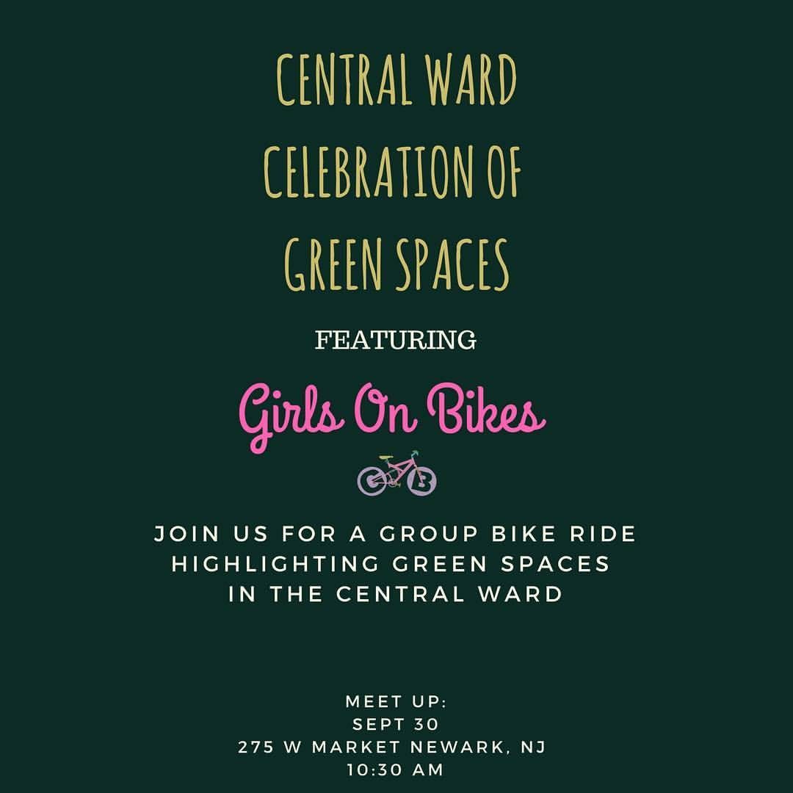
Girls on Bikes... “creating a culture of unstoppable women”
“It is important that we disintegrate the norm of colored people who are viewed as unfortunate while riding bicycles. Girls on Bikes intends to produce a new benchmark of strong and fearless women ready to conquer the world. By doing so we will continuously increase the power of girls and young women for many generations to come.”
Notes:
MISSION
To enhance and strengthen the mentality of girls and young women in the urban community through participation in recreational activities.
OTHER PROGRAMS:
Programs for middle school to college students to explore the social and political constructs associated with non-white girls and women participating in recreational activities in public
Active social media presence
“Learn How to Ride” every first and third Sunday in Military Park

Slide 7
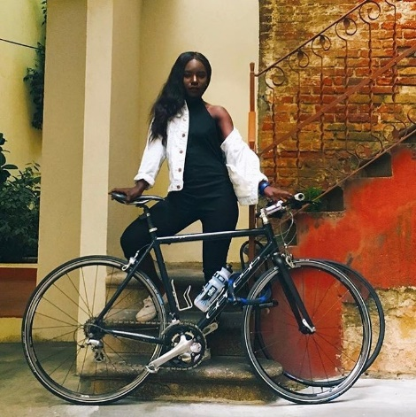
Girls on Bikes... “creating a culture of unstoppable women”
Integrating cycling with fashion
One of the founders began styling women and then going on bike rides together while having a conversation about what it means for a black girl to be on a bike.
Photo shoot image from Girls on Bikes Facebook with model @akuabarbara_ (Source: https://www.facebook.com/girlsonbikess)
Notes:
Trying to overcome barriers to bicycling due to personal safety, coolness, hygiene/messy hair

Slide 8
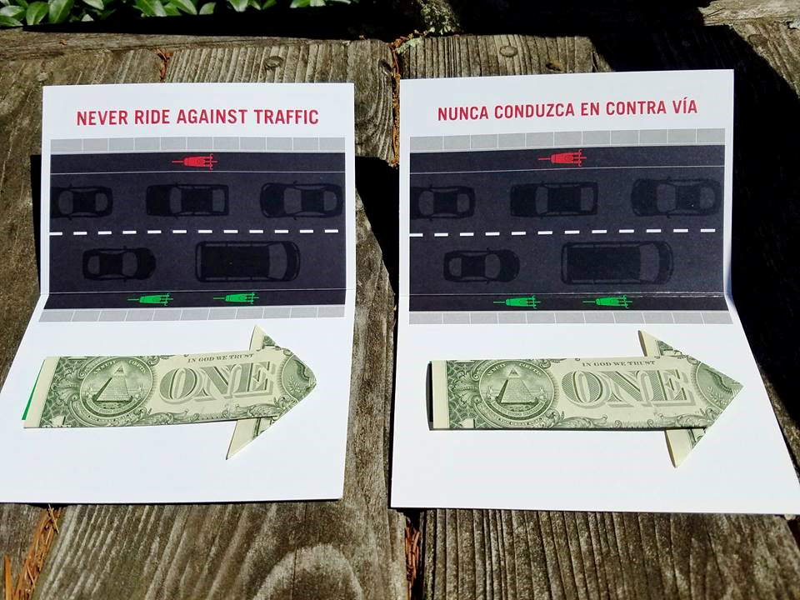
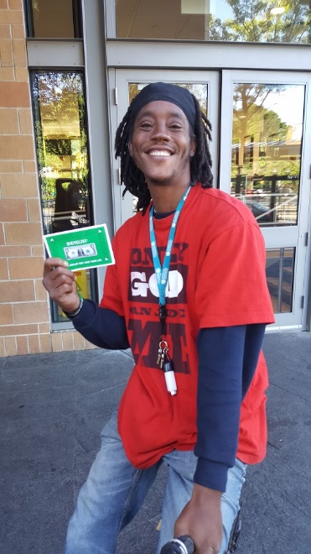
Dollar Campaign/D&R Greenway Land Trust
Bicyclist with the Dollar card (Source: Jay Watson, D&R Greenway Land Trust)
Notes:
Funded William Penn foundation
This dollar may save your life – English/Spanish versions
Intercept approach (but thus far no Spanish speakers handing out cards)
Relatively cheap ($1,000)
Dollar as an Icebreaker

Slide 9
Urban Bike Project – Wilmington, DE
“Equity and resiliency in community – through an emphasis on serving underserved populations.”
Vision:
“bicycling is a building block of resilient communities, which means a community that is connected, that nurtures a strong social fabric in which residents look out for each other and the built space of the city
Bicycling should be a viable option for people looking to secure and maintain employment
Notes:
Started 2005, 501(c)(3) 2006

Slide 10
Urban Bike Project – Wilmington, DE
Community-driven: Urban Bike Project strives to meet the needs of the community, as defined by the community and through partnerships.
Education: Programs empower adults to make safer choices about bicycling as a means of transportation and recreation. Also expand access to bicycles.
Open access: The open shop hours are available to anyone who is interested in purchasing (or bartering for) a low-cost bicycle, receiving help repairing a bicycle, or learning more about bicycling in the area.
Notes:
Started 2005, 501(c)(3) 2006
Full time, paid Executive Director and one other paid staff
60 to 70 volunteers
Free Bike program

Slide 11
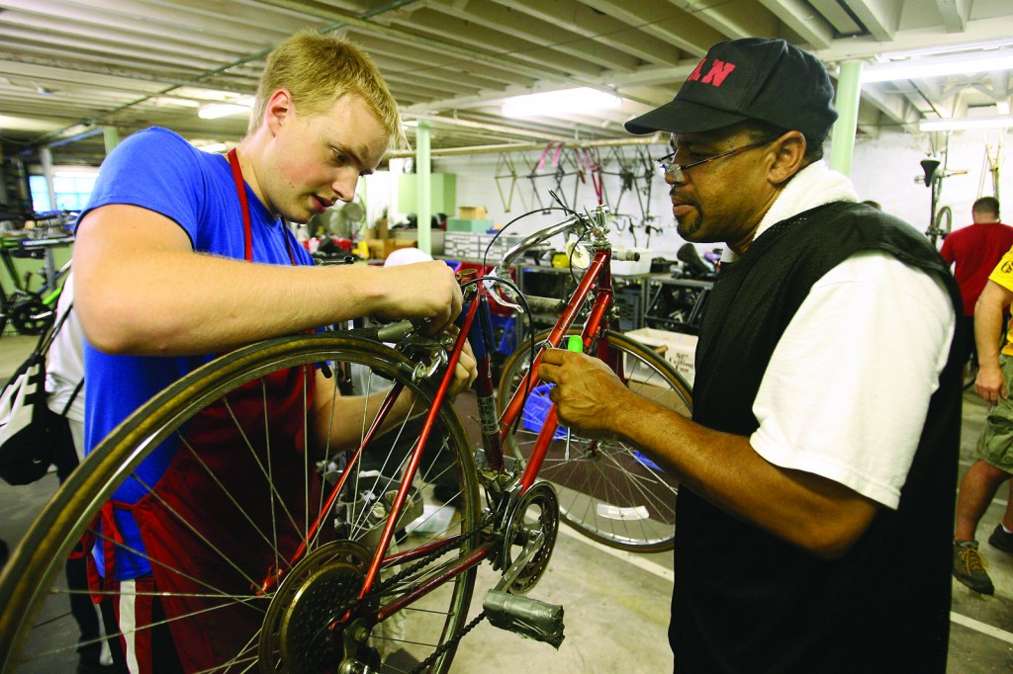
Urban Bike Project – Wilmington, DE
Notes:
Has built relationships with other social service agencies and homeless shelters that refer people in need of transportation

Slide 12
Lessons Learned
Rutgers, The State University of New Jersey www.policy.rutgers.edu

Slide 13
Lessons Learned
Community-driven (and community led) education and outreach is strongly relevant, even in our increasingly social media driven world
Physical space still matters
RIDING together still matters
Partnerships and access to local government leaders enhance networks and social capital in communities
There is value in an explicit equity focus in organizational mission/vision and strategy development and program delivery
Outside funders are interested in piloting easy to replicate, educational campaigns and events (Dollar Campaign, Pedal to Porch)

